Slide 1


Slide 2
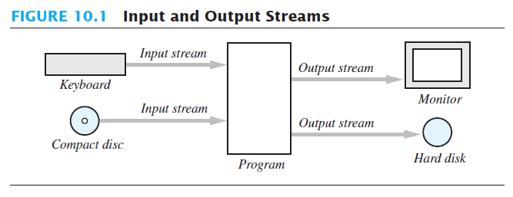

Slide 3
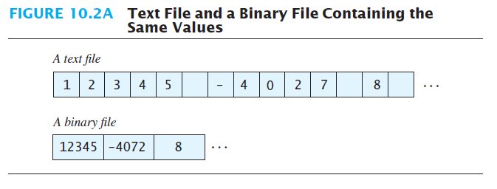

Slide 4
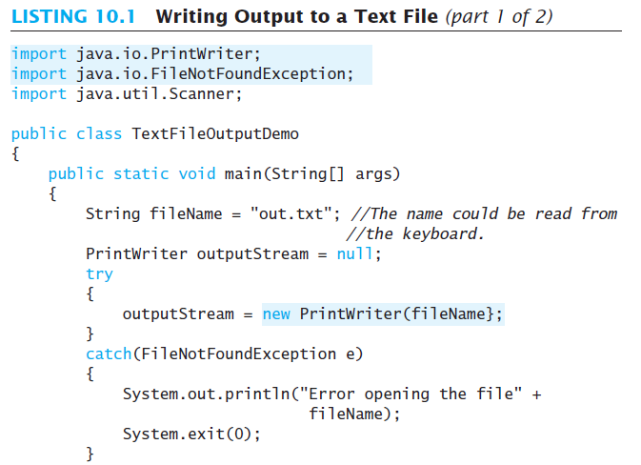

Slide 5
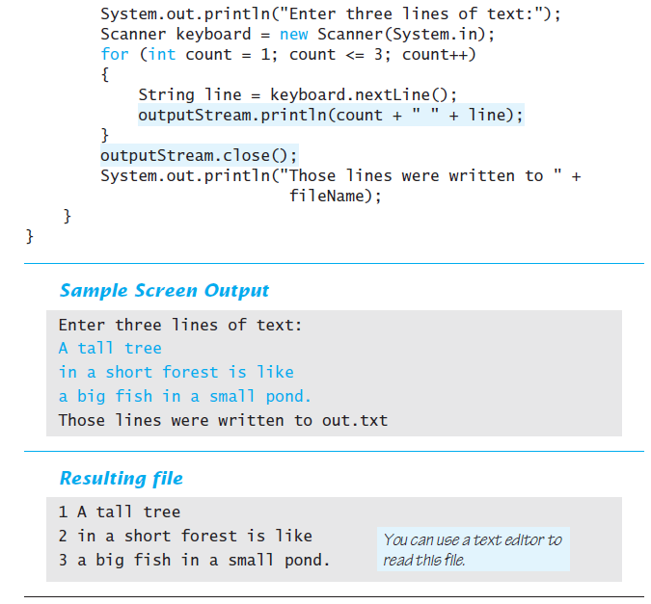

Slide 6
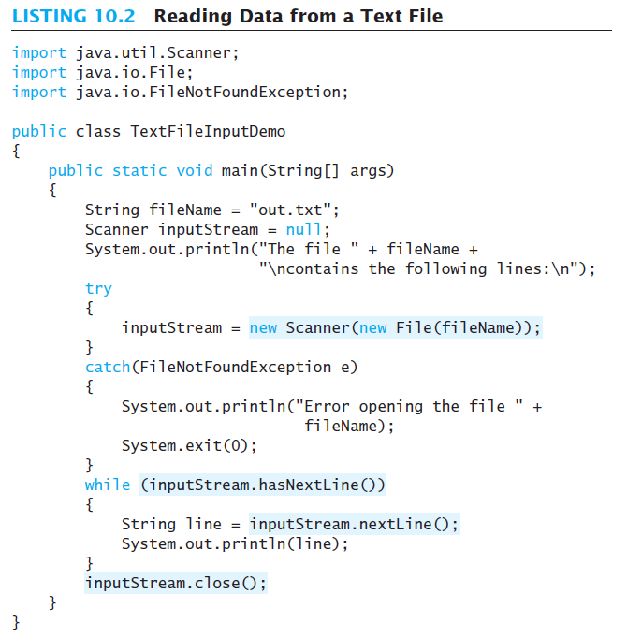

Slide 7
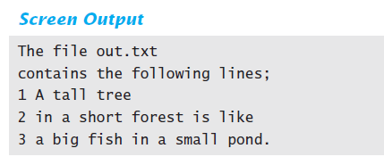

Slide 8
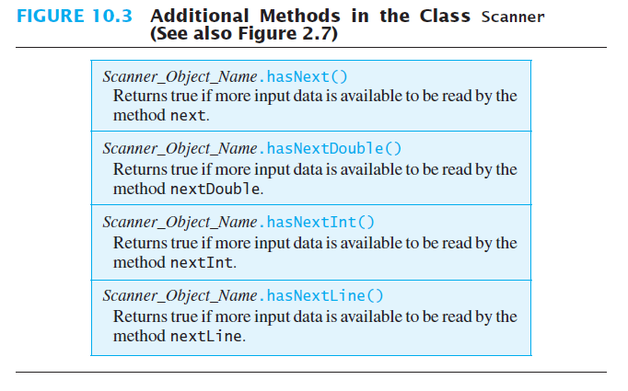

Slide 9
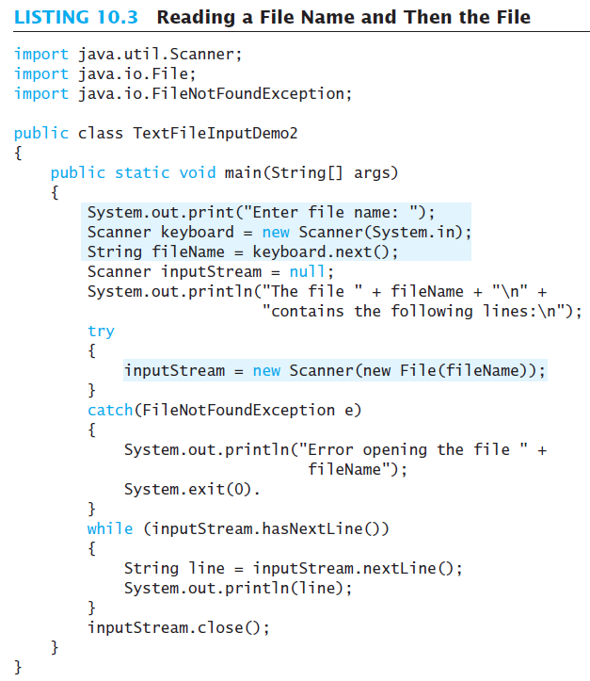

Slide 10
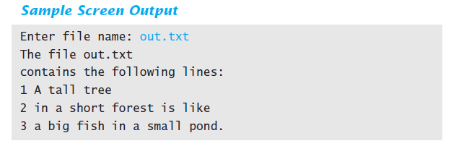

Slide 11
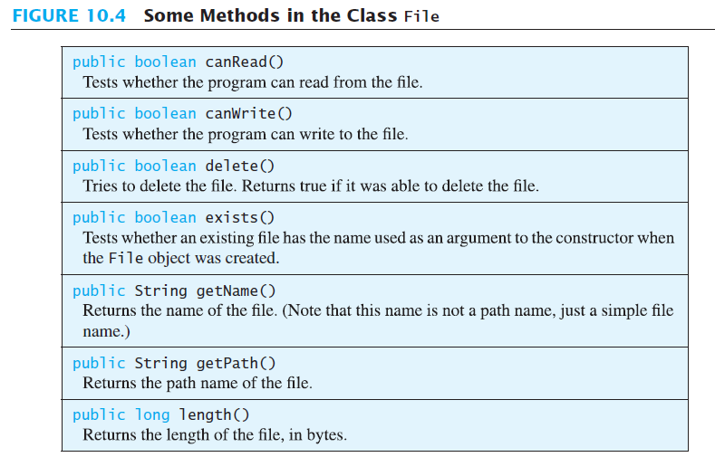

Slide 12
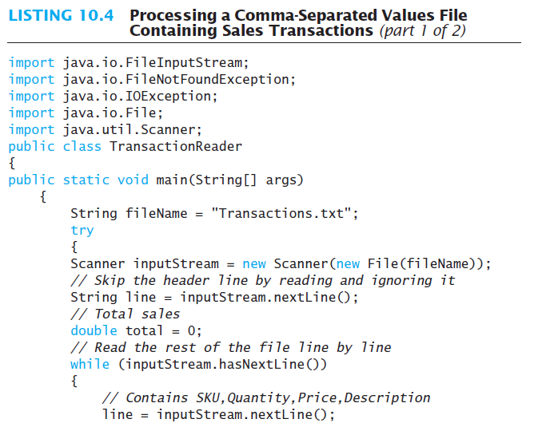

Slide 13
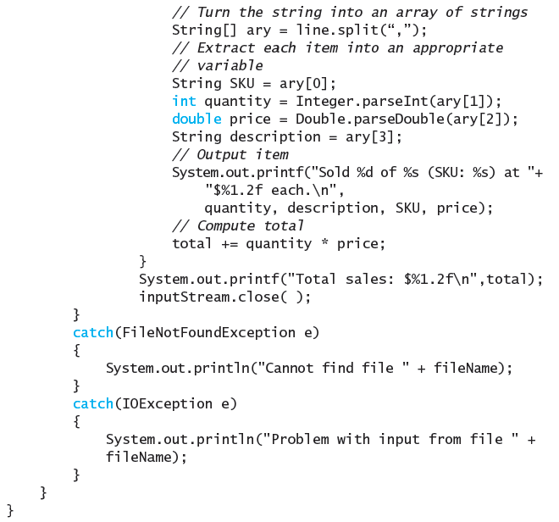

Slide 14
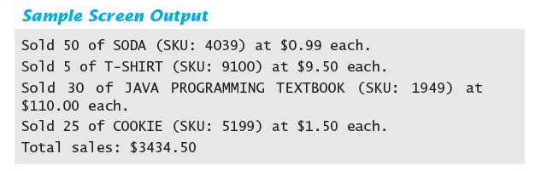

Slide 15
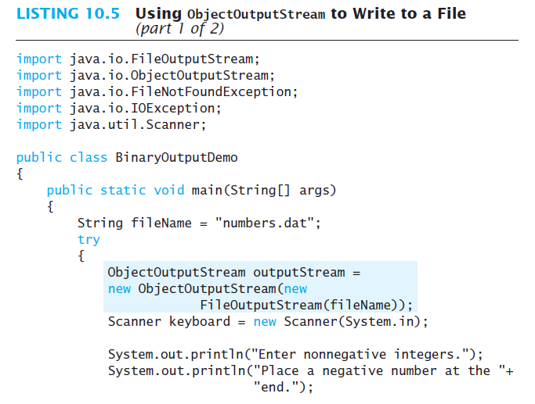

Slide 16
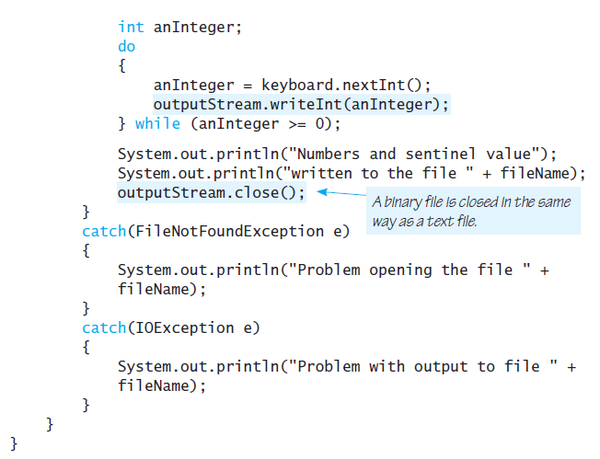

Slide 17
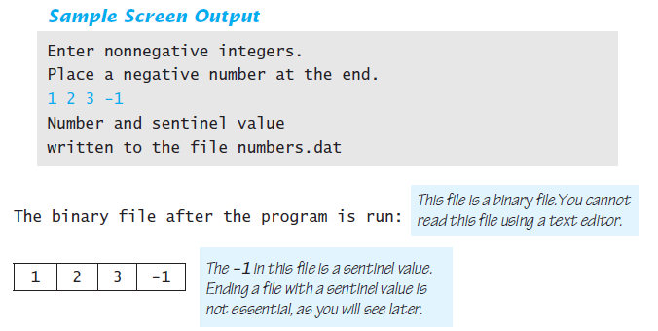

Slide 18
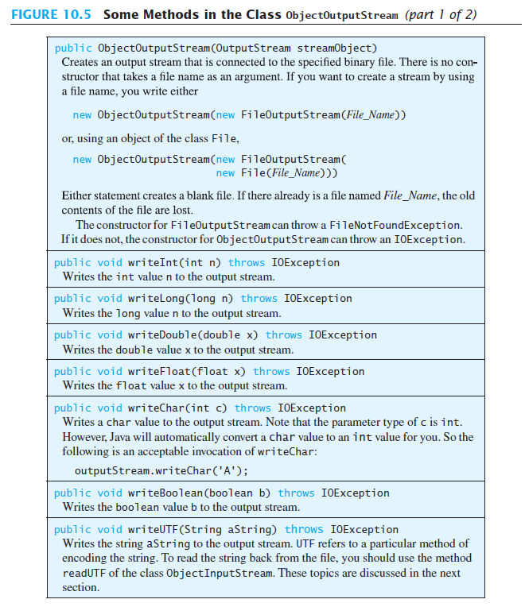

Slide 19
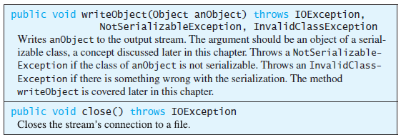

Slide 20
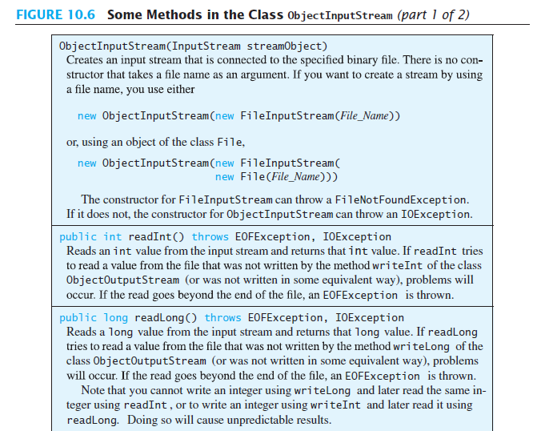

Slide 21
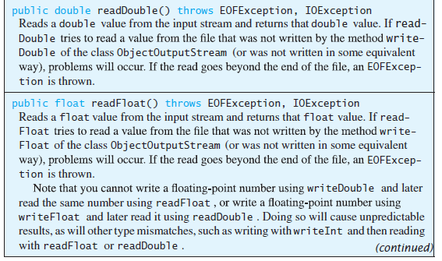
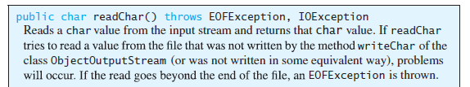

Slide 22
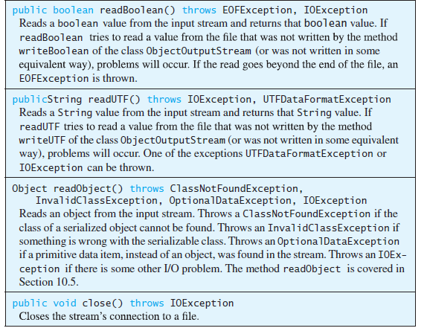

Slide 23
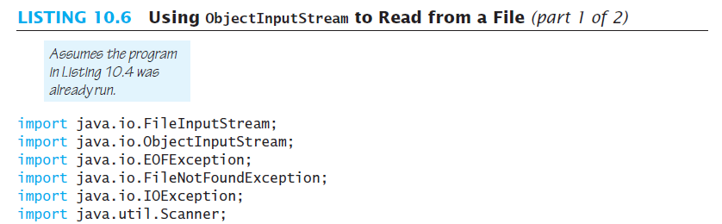

Slide 24
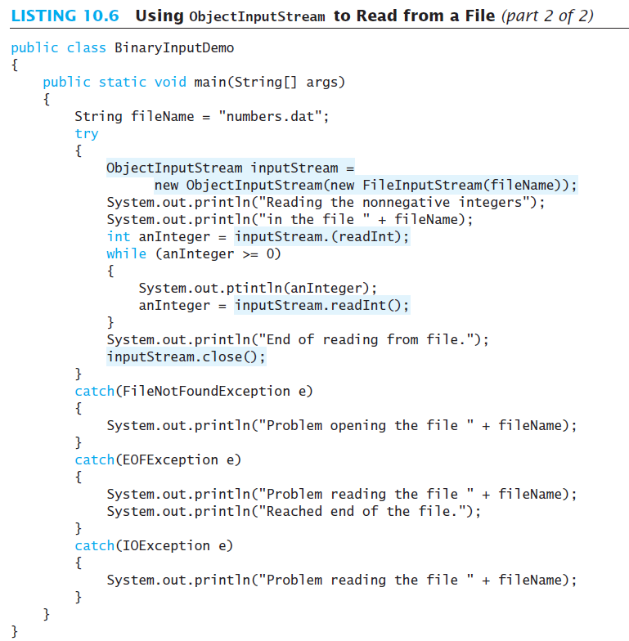

Slide 25
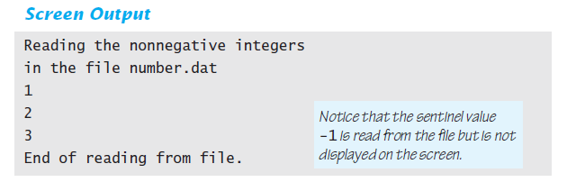

Slide 26
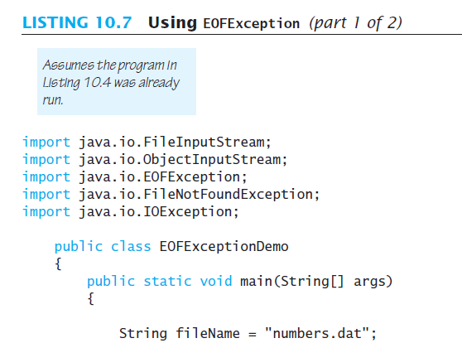

Slide 27
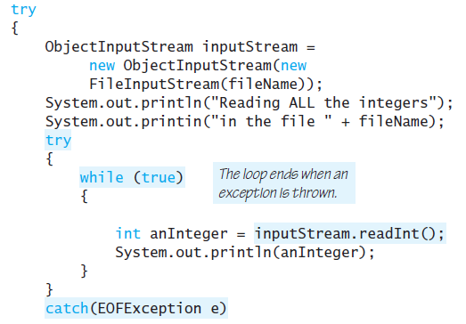
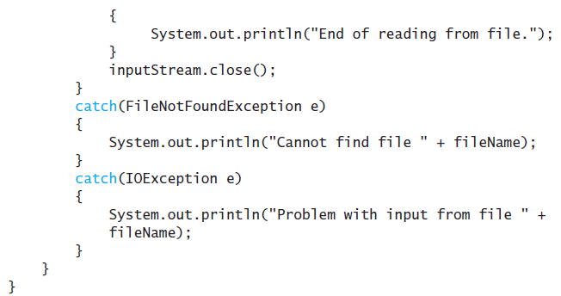

Slide 28
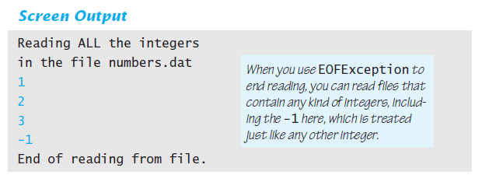

Slide 29
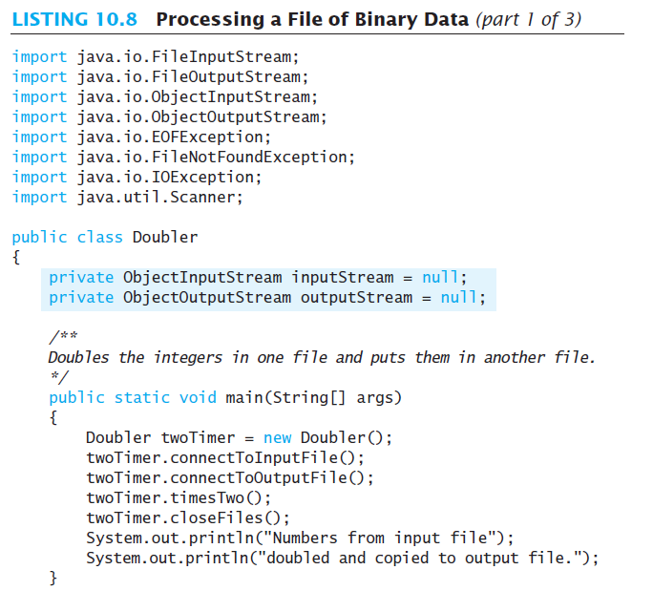

Slide 30
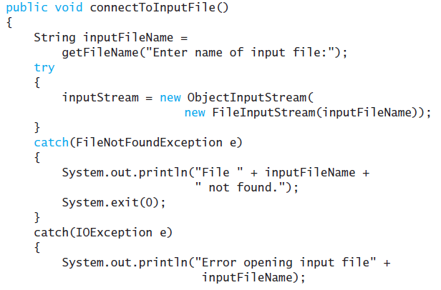


Slide 31
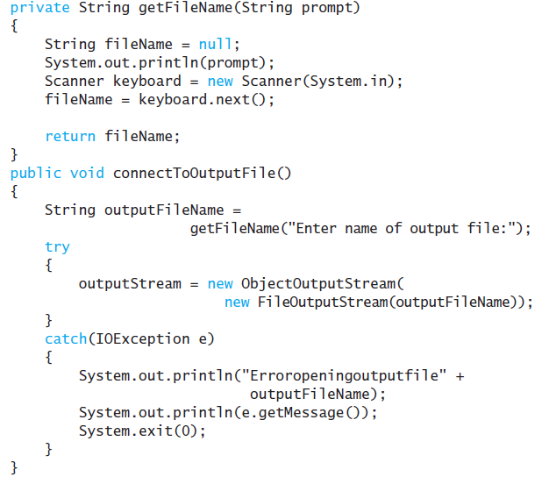

Slide 32
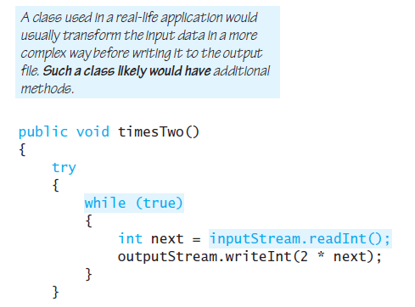

Slide 33
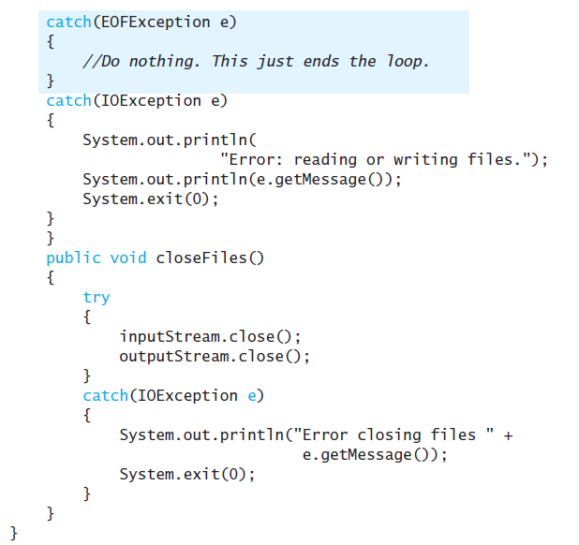

Slide 34
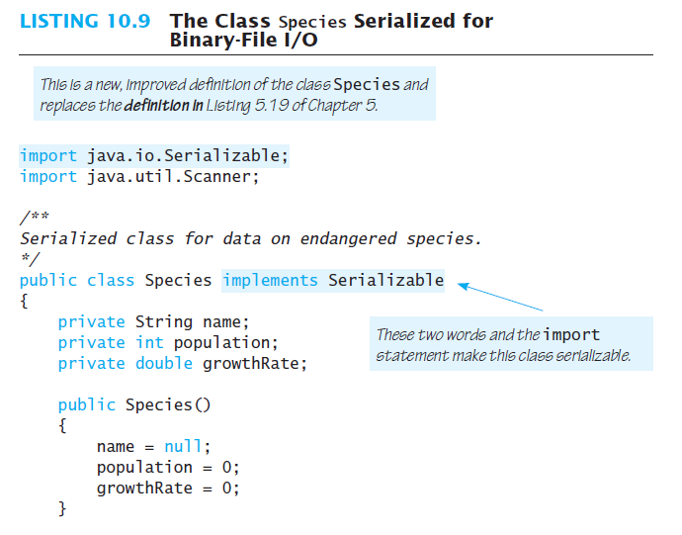

Slide 35
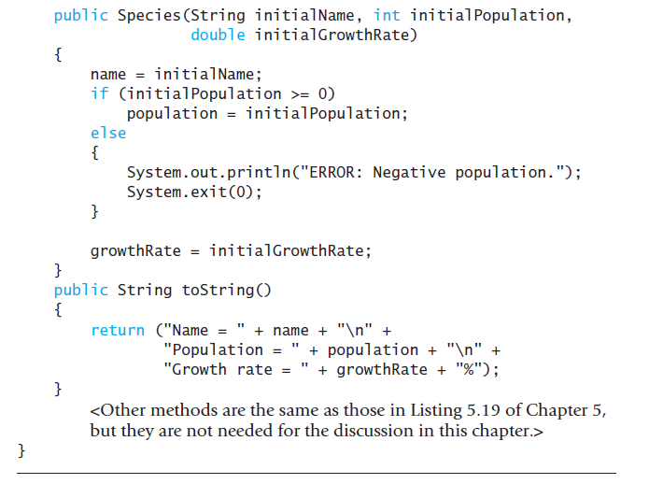

Slide 36
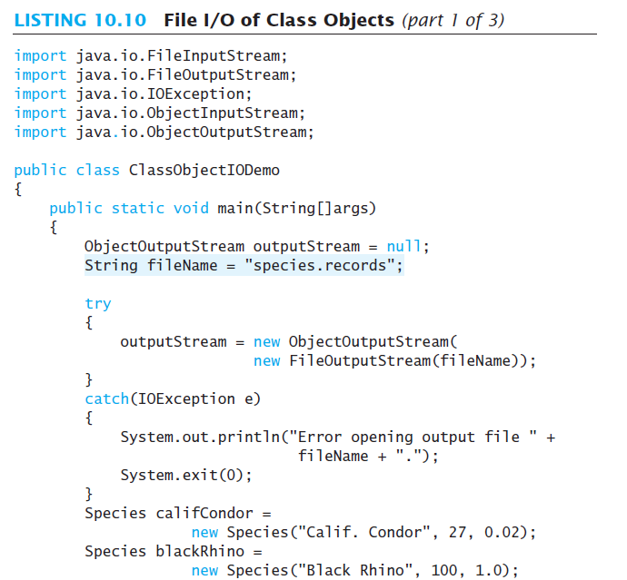

Slide 37
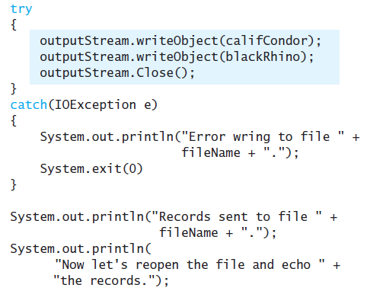

Slide 38
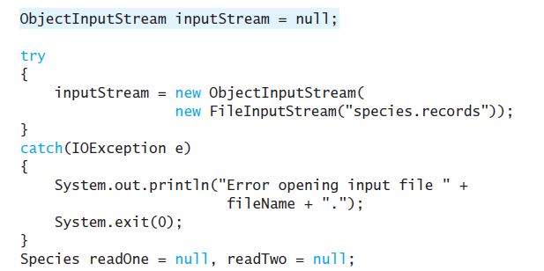

Slide 39
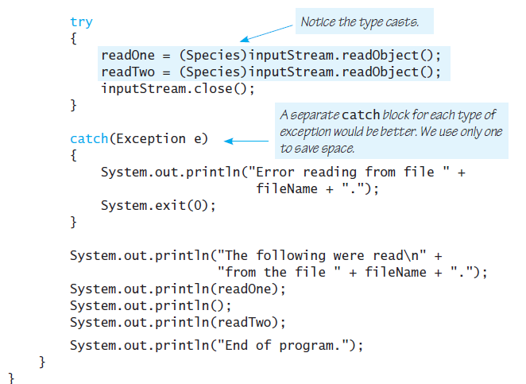

Slide 40
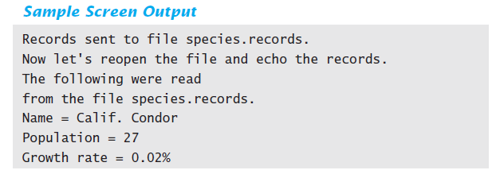
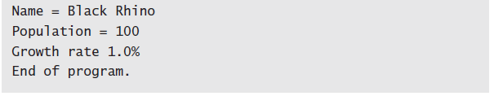

Slide 41
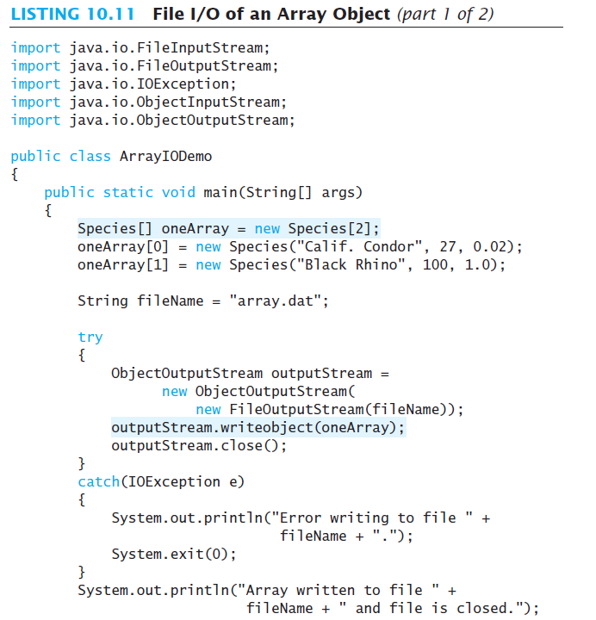

Slide 42
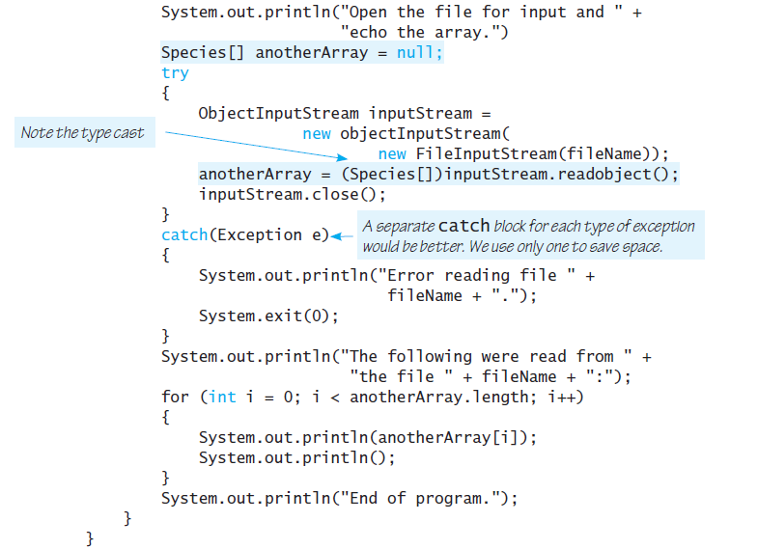

Slide 43
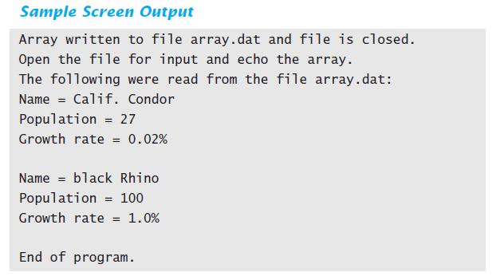

Slide 44
FIGURE 10.7 Client/Server Network Communication via Sockets
The Java server program listens and waits for a connection on port 6789. Different programs may be listening on other ports.
Server Computer
port 0
port 1
In Listing 10.13 the server and client are running on the same computer which is identified by the special address of “localhost”.
Java
server
program
…
port 6789
…
The Java client program connects to the server on port 6789. It uses a local port that is assigned automatically, in this case, port 8312.
Server Computer
Client Computer
port 0
port 0
port 1
port 1
Java
server
program
…
Network
…
Java
client
program
port 6789
port 8312
…
…
The Java server program can now communicate over a socket bound locally to port 6789 and remotely to the client’s address at port 8312, while the client communicates over a socket bound locally to port 8312 and remotely to the server’s address at port 6789.

Slide 45
LISTING 10.12 Network Server Program
import java.util.Scanner;
import java.io.InputStreamReader;
import java.io.DataOutputStream;
import java.io.PrintWriter;
import java.net.Socket;
import java.net.ServerSocket;
public class SocketServer
{
public static void main(String[] args)
{
String s;
Scanner inputStream = null;
PrintWriter outputStream = null;
ServerSocket serverSocket = null;
try
{
// Wait for connection on port 6789
System.out.println("Waiting for a connection.");
serverSocket = new ServerSocket(6789);
Socket socket = serverSocket.accept();
// Connection made, set up streams
inputStream = new Scanner(new InputStreamReader(socket.getInputStream()));
outputStream = new PrintWriter(new
DataOutputStream(socket.getOutputStream()));

Slide 46
// Read a line from the client
s = inputStream.nextLine();
// Output text to the client
outputStream.println("Well, ");
outputStream.println(s + " is a fine programming language!");
outputStream.flush();
System.out.println("Closing connection from " + s);
inputStream.close();
outputStream.close();
}
catch (Exception e)
{
// If any exception occurs, display it
System.out.println("Error " + e);
}
}
}
Screen Output
After running the client program in Listing 10.13.
Waiting for a connection.
Closing connection from Java

Slide 47
LISTING 10.13 Network Client Program
import java.util.Scanner;
import java.io.InputStreamReader;
import java.io.DataOutputStream;
import java.io.PrintWriter;
import java.net.Socket;
public class SocketClient
{
public static void main(String[] args)
{
String s;
Scanner inputStream = null;
PrintWriter outputStream = null;
try
{
// Connect to server on same machine, port 6789
Socket clientSocket = new Socket("localhost",6789);
// Set up streams to send/receive data
inputStream = new Scanner(new
InputStreamReader(clientSocket.getInputStream()));
outputStream = new PrintWriter(new
DataOutputStream(clientSocket.getOutputStream()));
// Send "Java" to the server
outputStream.println("Java");
outputStream.flush(); // Sends data to the stream

Slide 48
// Read everything from the server until no
// more lines and output it to the screen
while (inputStream.hasNextLine())
{
s = inputStream.nextLine();
System.out.println(s);
}
inputStream.close();
outputStream.close();
}
catch (Exception e)
{
// If any exception occurs, display it
System.out.println("Error " + e);
}
}
}
Screen Output
After running the client program in Listing 10.12.
Well,
Java is a fine programming language!

Slide 49
URL Class
URL website = new
URL("http://www.wikipedia.org");
Scanner inputStream = new Scanner(
new InputStreamReader(
website.openStream()));
while (inputStream.hasNextLine())
{
String s = inputStream.nextLine();
System.out.println(s);
}
inputStream.close();

Slide 50
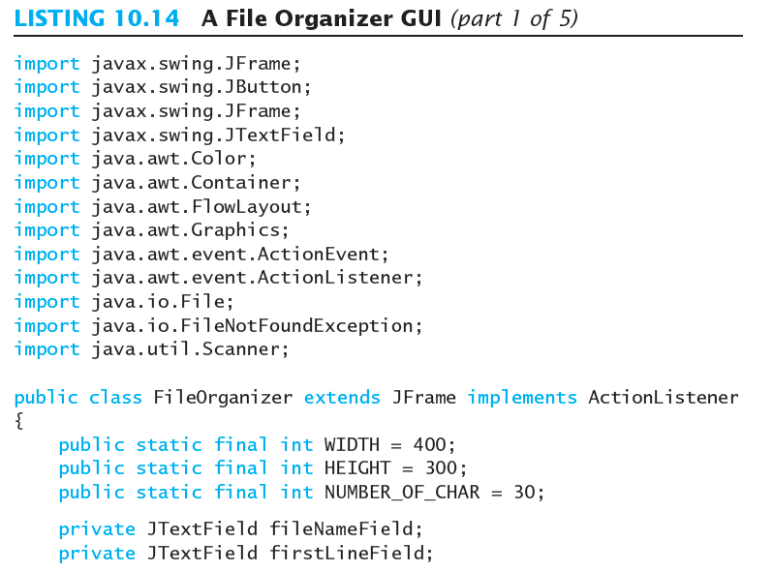

Slide 51
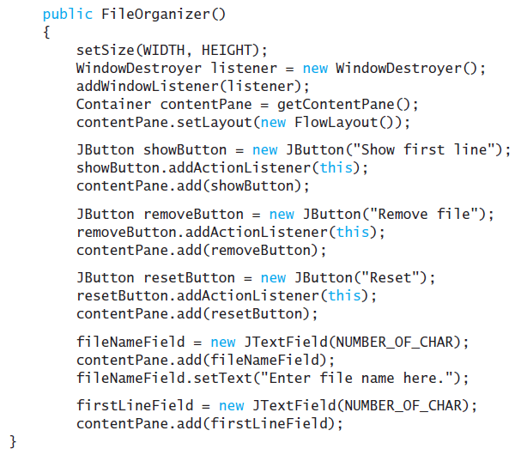

Slide 52
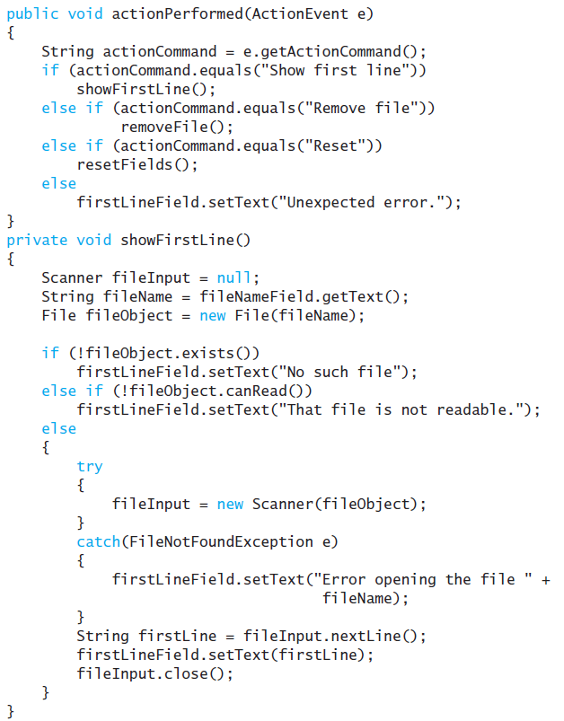

Slide 53
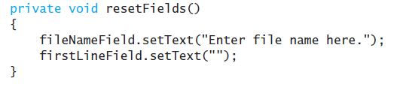
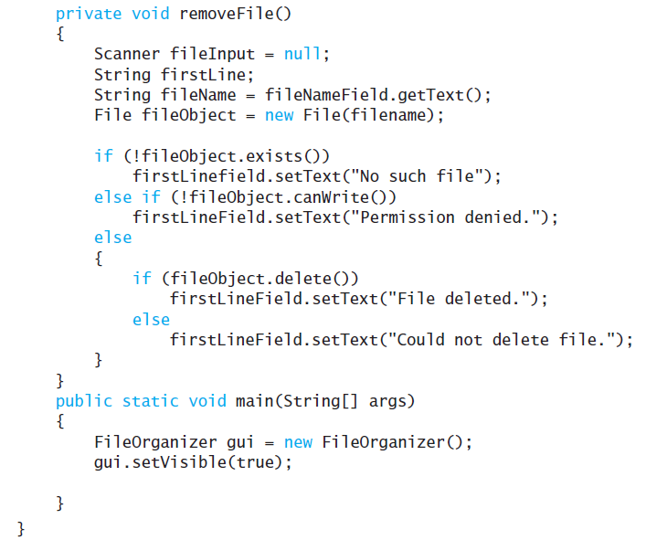

Slide 54


Slide 55


Slide 56


Slide 57


